Slide 1


The development and implementation of a national reporting system for self-harm in Irish prisons
SADA project
Sarah Hume & Enda Kelly
LEPH International Conference
21-23 October 2019 Edinburgh, Scotland.

Slide 2
Background
Large-scale studies of self-harm in prisons are rare.
Small studies estimate prevalence rates between 5-24%.
  National study of prisoners in England and Wales over a five-year period, reported 6% of prisoners self-harmed each year (Hawton et al, 2014)
  Previous recording of self-harm in Irish prisons reported approximately 170 incident in 2004, representing 3.8% of all prisoners (NSRF, 2005)
Risk factors for self-harm among prisoners include white ethnic origin, previous self-harm and presence of mental disorder.
  Complex interactions between individual-level and ecological factors, and that suicide prevention should address both individual and system-level risk factors.
Moderate/ high lethality and repeated self-harm are associated with risk of suicide.
Notes:
Much of our research on morbidity with regards to suicide research focuses on suicide attempts and self-harm, and several registries exist which monitor hospital-presenting self-harm
Continuum ranges from thoughts of self-harm and/or suicide to both non-fatal and fatal self-harm (Naghavi, 2019; Goodfellow et al, 2018)
Suicidal ideation has been recently highlighted as an intervention target that has been overlooked in suicide-related research and international policies (Jobes and Joiner, 2019)
Suicidal ideation is an important marker for future suicide
Although most of suicide prevention efforts have been given to suicide attempts,

Slide 3


Rationale
IPS committed to leading suicide prevention efforts in custodial settings – part of national strategy.
Lack of timely, accurate data on self-harm in prisons.
Connecting for Life Goal &: Better Data and Research.
Project benefits:
Provide usable actionable data for the IPS and individual prisons to inform and drive change in policy & practice;
Introduces analysis of severity of harm v level of intent
Build support for research within the prison system;
Monitor and publish trends in suicide and self-harm.

Slide 4
Methodology
Data collection
Episodes of self-harm recorded in each prison by multi-disciplinary teams
Data collation/ verification
Compiled/ reviewed by internal IPS staff
Data analysis
Data collated/analysed/ reported by NSRF

Slide 5
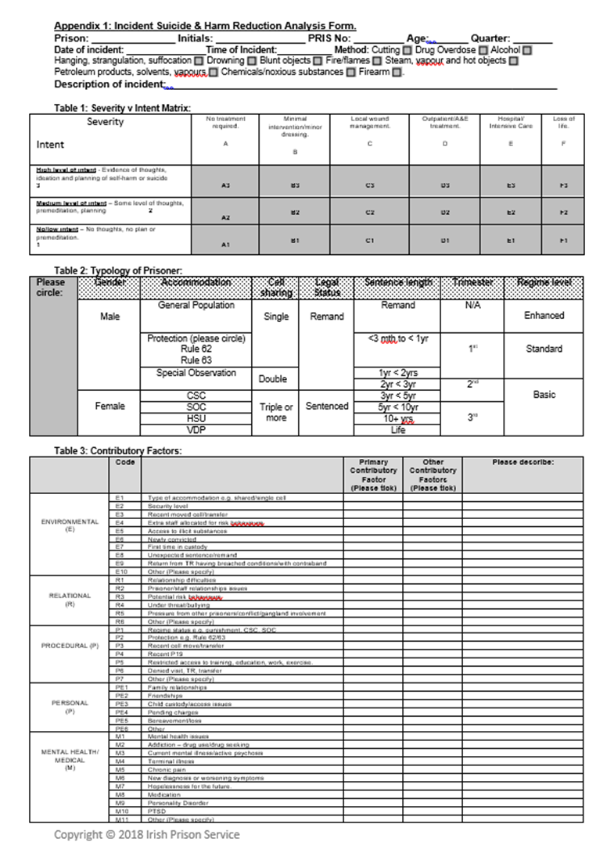
Data items
Demographics | Age, Sex, Prison Remand status, Sentence length Accommodation, regime level
Method of self-harm | ICD-10 codes X60-X84 Severity Intent
Contributory factors | Environmental Relational Procedural Personal Mental health/ medical
Notes:
Much of our research on morbidity with regards to suicide research focuses on suicide attempts and self-harm, and several registries exist which monitor hospital-presenting self-harm
Continuum ranges from thoughts of self-harm and/or suicide to both non-fatal and fatal self-harm (Naghavi, 2019; Goodfellow et al, 2018)
Suicidal ideation has been recently highlighted as an intervention target that has been overlooked in suicide-related research and international policies (Jobes and Joiner, 2019)
Suicidal ideation is an important marker for future suicide
Although most of suicide prevention efforts have been given to suicide attempts,

Slide 6
Inclusion criteria
Exclusion criteria
All methods where self-harm was intentional
Food and/or fluid refusal
Overdose of prescription or illicit substances
Alcohol overdose
Behaviour where there is no intent to self-harm
Accidental overdoses without any intention to self-harm
Recreational drug use
Alcohol overdose without intent

Slide 7
Rate of self-harm among prisoners
 | Individuals | Episodes | Rate per 100 (95% CI)
Total | 138 | 223 | 4.0 (3.4 - 4.8)
Male | 119 | 178 | 3.6 (3.0 – 4.3)
Female | 19 | 45 | 16.0 (9.6 – 24.9)
Sentenced | 94 | 156 | 3.1 (2.5 – 3.8)
On remand | 43 | 66 | 7.4 (5.3 – 9.9)
Notes:
In 2017, there were a total of 223 episodes of self-harm, involving 138 individuals
Taking into account the prison population, there were 4.0 self-harm episodes per 100 prisoners
The rate was 4 times higher among females
And was two times higher for remand prisoners

Slide 8
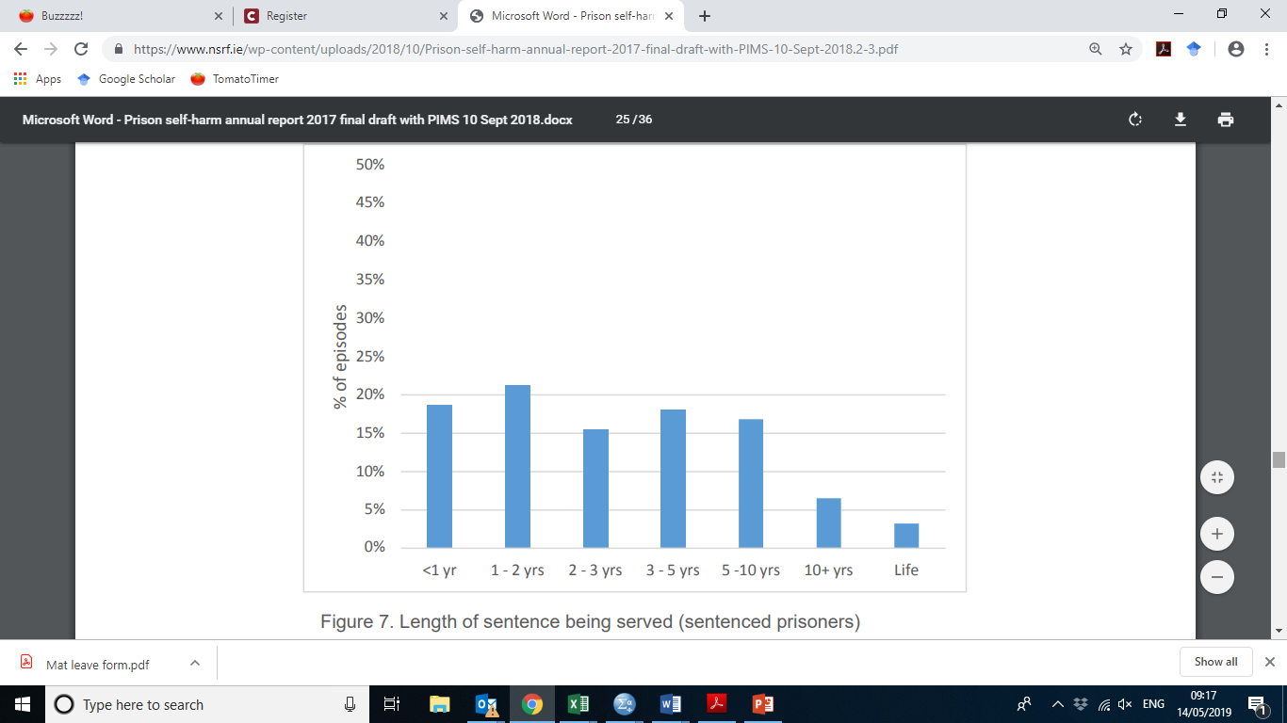
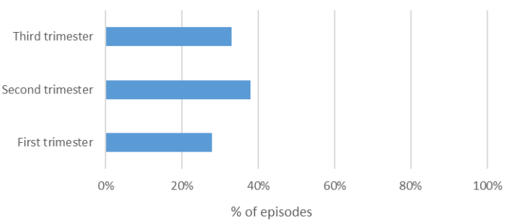
Accommodation/ cell-type and sentencing
77% (n=172) were in single cell accommodation at the time of self-harm act (note most of IPS accommodation is now single cell accommodation)
Notes:
The majority of self-harm episodes involved prisoners who were in single cell accommodation
Almost 90% of the self-harm episodes were among prisoners,
Eleven self-harm episodes involved prisoners from high support units.

Slide 9
Method of self-harm
Male
Female
Notes:
Overall, self-cutting or scratching was the most common method occurring in 62% of episodes, followed by attempted hanging involved in 1 in 5 episodes.
Attempted hanging episodes were more common among female prisoners while cutting was more common among males.

Slide 10
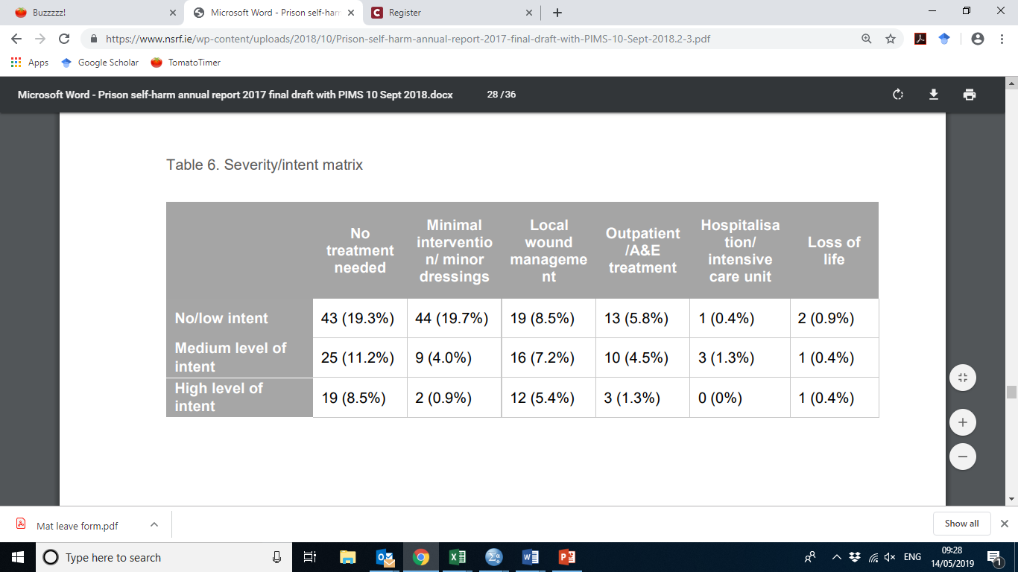
Severity and intent
Notes:
Approximately 85% of episodes required minimal or no treatment or local wound management. In 2017, 4 self-harm acts involved loss of life.
About half of episodes were deemed to be of no or low intent while a further third were recorded as medium intent.
Of the eight cases that required hospitalisation or resulted in the loss of life, three of these were deemed as having no/low intent, four to have medium intent and one to have had high intent.

Slide 11
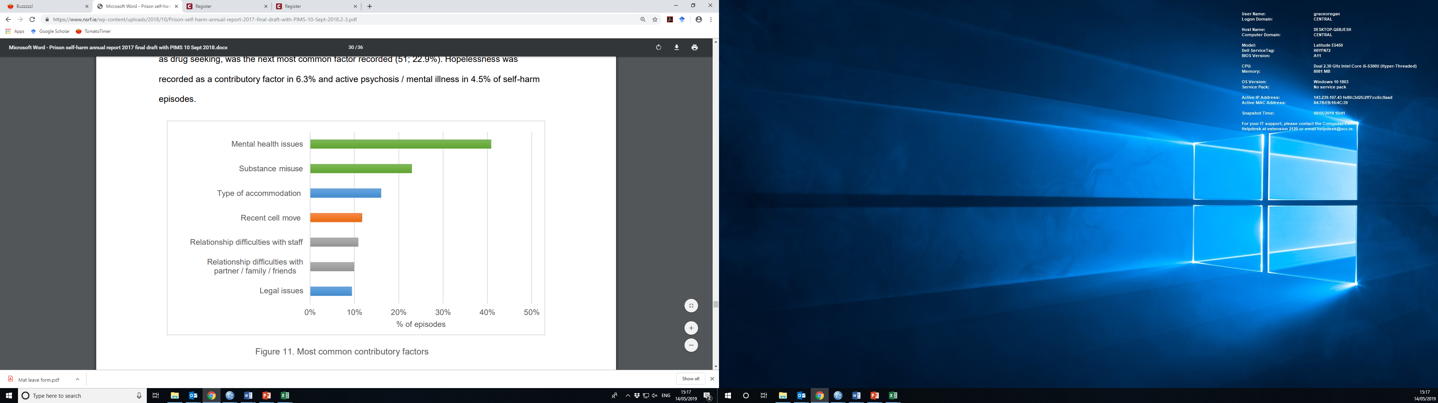
Most common contributory factors
Contributory factors
Notes:
Mental health issues and substance misuse were the most common contributory factors involved.
Prison specific factors, including accommodation type and a recent cell move were also common factors listed.
Relationship difficulties both with prison stagg and personal relationships were also common

Slide 12
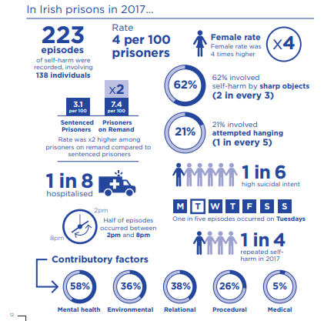

Slide 13
Value and impact of project
Generating knowledge and awareness
Data integrity, leading to trust and buy-in
Responses within system
Notes:
Opening discussion of suicide and self-harm
Building awareness
Official report and reviewing
What is the function? Need to be clear
Trust and interpretation
Electronic version of form
Continued buy-in
Whole prison arrpoach and shared understanding
Early stages pilot data
Information sharing
Now multi-d meetings in every prison

Slide 14
5 Nations Collaborative Benefits
Inter-professional and International.
Opportunity to collaborate and extend understanding across “same but different services”.
Benefit in improved patient outcomes, fewer preventable errors, reduced healthcare costs, and improved relationships with other disciplines.
Minimizing duplicated effort and increasing knowledge.
Leads to better understanding of a seldom recognised speciality of healthcare provision.

