Slide 1
MONITORING DIFFERENT TYPES OF TRIALS.
BY
OGUNDOKUN OLUSEGUN
BIOMEDICAL SCIENTIST / CLINICAL RESEARCH PROFESSIONAL
BMLS (LAUTECH), PGD (Clin. Research. ICH-GCP, GLP,GMP) Canada.)

Slide 2
WHAT ARE CLINICAL TRIALS?
Clinical Trials are research studies involving people.
They test whether particular treatments / devices are safe and how well they work.
These are different from legal trials.

Slide 3
TYPES OF CLINICAL TRIALS
Phase I Study
Phase II Study
Phase III Study
Randomized Control Trial (RCT)

Slide 4
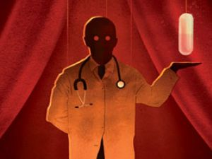

Slide 5
CURRENT CLINICAL TRIALS IN NIGERIA
Trial on 1.0% C31G SAVVY vaginal gel for the treatment of HIV infections by NIMR (Lagos)
Trial on High Blood Pressure (Hypertension) by National Hospital Abuja, Nigerian Defence Medical Center (Abuja), Bwari General Hospital, State House Medical Center, and Gwagwalada specialist Hospital.

Slide 6
Trial on HIV treatment by IHVN
Trial on treatment of malaria by College of Medicine, UNILAG
Trial on treatment of Rheumatoid Arthritis by College of Medicine, UNILAG
Trial on the use of Probiotics for the treatment of Vaginal Candidiasis by Faith Mediplex

Slide 9
A CLINICAL TRIAL MONITOR
A Monitor is an independent professional who oversees the progress of a clinical trial by systematically examine the trial related activities and documents to determine whether the evaluated trial activities were conducted and the data recorded, analysed and accurately reported according to the protocol, Sponsor’s SOPs, ICH-GCP and applicable regulatory requirement.

Slide 10
Reasons for a monitor
To protect the right and well-being of human subjects.
To make sure the reported trial data are accurate, complete and verifiable from source documents.
To make sure the conduct of trial is in compliance with protocol, GCPs and applicable regulatory requirements
ICH- 5.18.1

Slide 11
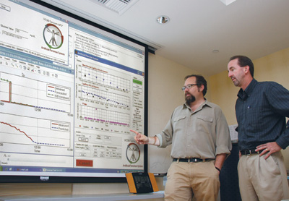
WAYS OF TRIAL MONITORING
Home-based Monitoring
Field Monitoring

Slide 12
FACTORS THAT DETERMINE THE NUMBER OF MONITOR FOR A TRIAL

Slide 13
WHAT DOES MONITORING INVOLVE?
Collection of evidence and compare against standards (Retrospective sampling)
Observation of documents
Seriousness assessment
Checking whether the subjects enrollment are according to ICH-GCP guidelines
Checking for fraud
Recommend actions

Slide 14
STAGES OF MONITORING PROCESS
PRE-INVESTIGATION VISIT
Understand requirements for an adequate and well-controlled study.
Has adequate facilities for conducting the trial
Has access to an adequate number of suitable subjects
Understand and accepts his/her obligation to obtain informed consent, IRB review and approval according to 21CFR part 50 and 21CFR part 56.

Slide 15
ON-GOING PERIODIC VISIT
Verifying that the facilities used by the investigator continue to be acceptable for purposes of the study.
Making sure study protocol or investigational plan is being followed.
Verifying that changes to the protocol have been approved by the IRB and/or reported to the sponsor and the IRB.
Making sure that accurate, complete, and current records are being maintained.
Making sure that accurate, complete, and timely report are being made to the sponsor and IRB.
Making sure the investigator is carrying out the agreed-upon activities and has not delegated them to other previously unspecified staff.
Notes:
It is not easy to maintain your position of authority if the relationship becomes too friendly.

Slide 16
SITE CLOSE OUT VISIT
Checking the last visit report for any noted problems and unresolved issues.
Clarifying any open questions about the data collected
Ensuring that any investigational medicinal products, medical devices and trial remaining are dealt with correctly.
Discussing responsibilities after the end of the trial.

Slide 17
EVALUATION PROCESS
Evaluation is a systematic determination of a trial’s merit, worth and significance, using criteria governed by a set of standards.

Slide 20
needed forms and checklists

Slide 21
Feasibility Questionnaire
Site contract (Investigator/site agreement)
Study SOPs
Study protocol
Investigator bronchure
Research site evaluation form
Site timelines form
Site initiation checklist
Periodic monitoring checklist
Case report form
Close out visit checklist
Patient bronchure
Monitoring schedule-subject tracking form

Slide 22
IRB documents
Investigators meeting report form
Evaluation of subject enrollment form
Monitoring visit follow up letter
Checklist and form to identify potential fraud and misconduct
Significant adverse events report form
Study termination visit confirmation letter
Monitoring report form
Final report form

Slide 23
FOOD FOR THOUGHT
FOUR THINGS YOU CANNOT RECOVER

Slide 48
THANK YOU ALL FOR THE ATTENTION.
ANY QUESTION?

